Slide 1


Mastering Bash
Loops, Conditionals & Functions
Presenter
Mohammad Anees Alam
Notes:
1.7.2013
1
‹#›

Slide 2
Topics for today!
Command & Process substitution
1
2
Loops & Conditionals
Hands-on Activity
3
4
Analyzing DevOps scripts
Functions & types
5
Notes:
1.7.2013
2
‹#›

Slide 3
Command & Process Substitution
Command Substitution
Process Substitution
    When the output of sub-command acts as an input to main command.
    When you want to treat the output of a command as an input file.
Syntax:
Syntax:
$(command)
command <(other_command)
Example:
Example:
mkdir $(date +%Y-%m-%d)
cat <(ls) <(date)
Output:
Output:
A directory named as current date is created.
The result of ls & date are displayed together.
Notes:
1.7.2013
5
‹#›

Slide 4
Loops in Bash
Loops in Bash allow you to execute a set of commands repeatedly.
Bash supports three types of loops: for, while, & until.
For
While
Until
1
    Repeats a block of code for specific times for each item in a list or range.
2
3
    Repeats the block of code as long as a given condition is true.
    Repeats commands until a condition is true.
    Continues the loop even if the condition is false but, will exit when condition is true.
    Used when the number of iterations is known beforehand.
    Exits the loop if, the condition is false.
Notes:
1.7.2013
6
‹#›

Slide 5
Summary of All Three Loops:
Loop Type
Condition Check
Runs Until
Use
For
Iterates over a range or list
Set number of iterations
When you know the exact number of iterations or need to iterate over a list or range.
While
Condition is true
Condition becomes false
When you want the loop to continue as long as the condition is true.
Until
Condition is false
Condition becomes true
When you want the loop to continue until the condition becomes true.
Notes:
1.7.2013
7
‹#›

Slide 6
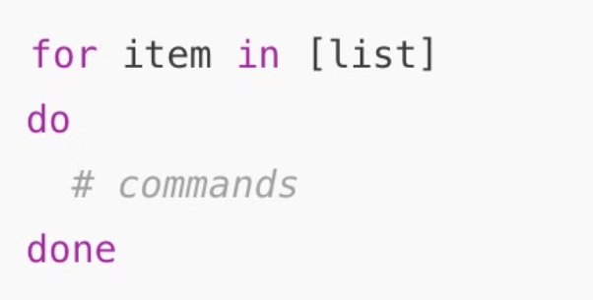
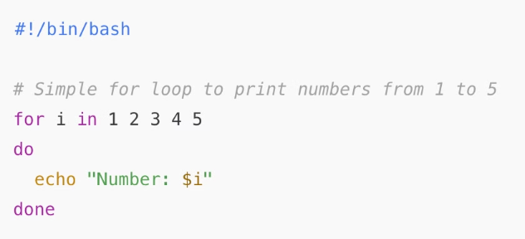
For Loop
    item: A variable that will take each value in the list, one by one.
    list: A list of items that will be iterated over (it can be numbers, strings, or even files).
SYNTAX
Expected Output:
Number: 1
Number: 2
Number: 3
Number: 4
Number: 5
Notes:
1.7.2013
8
‹#›

Slide 7
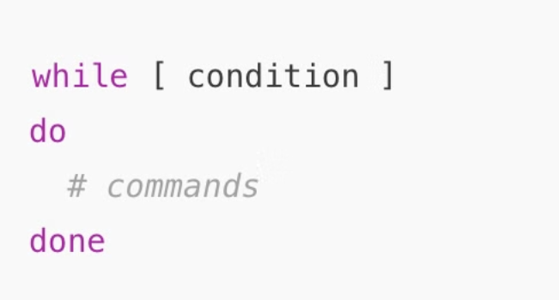
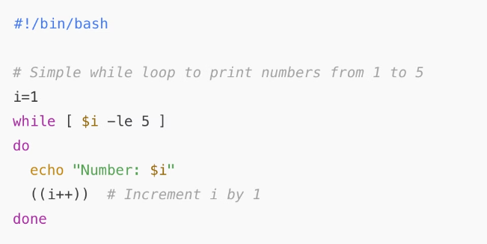
While Loop
    condition: A condition that will be checked before each iteration. If the condition is true, the loop continues; otherwise, it exits.
Expected Output:
SYNTAX
Number: 1
Number: 2
Number: 3
Number: 4
Number: 5
Notes:
1.7.2013
9
‹#›

Slide 8
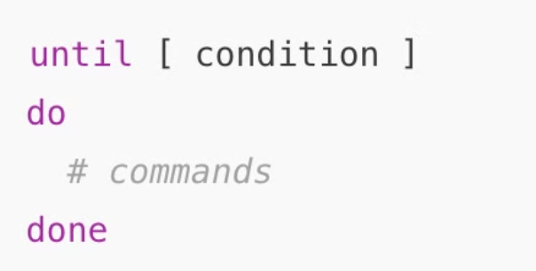
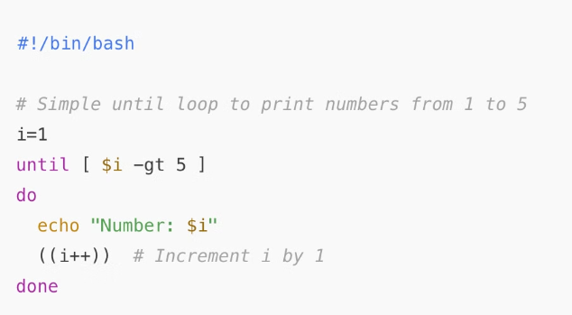
Until Loop
The until loop in Bash is the opposite of the while loop. It repeats the set of commands until a condition is true (i.e., the loop continues as long as the condition is false).
SYNTAX
Expected Output:
Number: 1
Number: 2
Number: 3
Number: 4
Number: 5
Notes:
1.7.2013
10
‹#›

Slide 9



Conditionals in Bash
Conditionals in Bash allow you to execute a set of commands based on whether a condition is true or false.
if Statement
Executes commands if the condition is true.
elif Statement
Allows you to check multiple conditions (else if).
else Statement
Executes the command if the if conditions are false.
Notes:
1.7.2013
11
‹#›

Slide 10
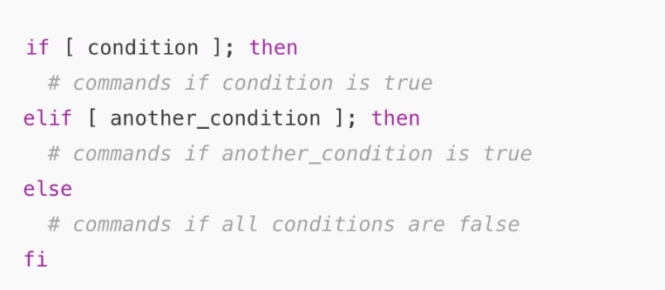
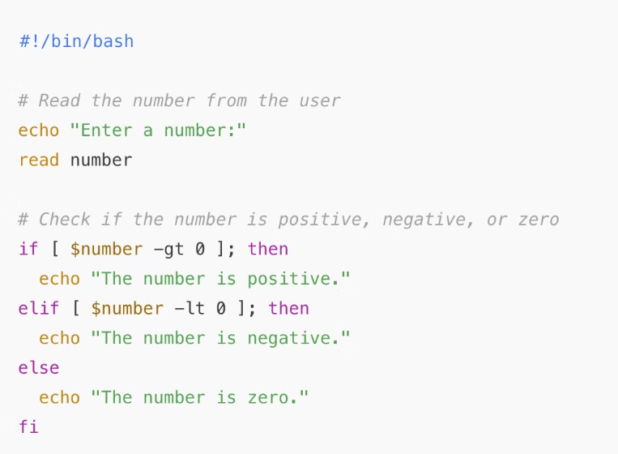
Conditionals script
Syntax
Expected Output:
Run the script and input different numbers to check the results.
Notes:
1.7.2013
12
‹#›

Slide 11
Few DevOps automation scripts
Let's analyze some real automation scripts to have some real perspective:
A script that creates 3 directories and 2 files inside each directory using loops & conditionals.
A script that validates and install the desired tools in our system using conditions.
Notes:
1.7.2013
13
‹#›

Slide 12



Functions in Bash
Code Reusability
1
Define once, use multiple times
2
Code Organization
Group related commands
3
Simplifies Scripts
Easier to read and maintain
    Functions in Bash allow you to group a series of commands together that can be executed with a single call.
    This helps in reusing code, organizing your script better, and making your code more modular and easier to read and maintain.
Notes:
1.7.2013
14
‹#›

Slide 13
Different ways to use functions - 1
Call a function
Function with Arguments
#Create a function()
#Define a function that accepts two arguments (name and age)
greet_user()
{
greet_with_age()
#Add commands
{
echo "Hello, welcome to Bash scripting!"
echo "Hello, $1! You are $2 years old."
}
}
#Calling the function
#Call the function with arguments
greet_user
greet_with_age "John" 25
Notes:
1.7.2013
15
‹#›

Slide 14
Different ways to use functions - 2
Function with Return Value
Function with Conditional Logic
#Define a function that adds two numbers
#Define a function to check if a number is even or odd
add_numbers() {
check_even_odd() {
#Adding the first and second arguments
if [ $(($1 % 2)) -eq 0 ]; then
result=$(( $1 + $2 ))
echo "The number $1 is even."
#Output the result to be captured
else
echo $result
echo "The number $1 is odd."
}
fi
#Capture the returned value in a variable
}
sum=$(add_numbers 10 15)
#Call the function with a number
#Print the result
check_even_odd 7
echo "The sum is: $sum"
Notes:
1.7.2013
16
‹#›

Slide 15

Key Takeaways
Substitution
Utilizing the output of a command in another part of the command.
Loops and Conditionals
Loops (for, while, until) allow repetitive execution of a block of code and conditionals (if, elif, else) allow controlling the flow of execution based on specific conditions
Functions
Utilize functions for code reusability & simplify complex scripts through various calling methods like arguments / return values / conditions.
Notes:
1.7.2013
17
‹#›

